Slide 1



Generative Ai SHR1_AIS2_M1e
GRADUATION PROJECT
CREATIVE WRITING
CHATBOT
Presented by:
Group 2

Slide 2


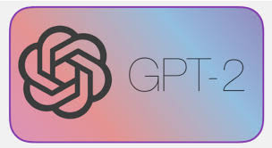
INTRODUCTION
GPT-2 OVERVIEW
GPT-2 is a generative language model by OpenAI designed to predict the next word in a sequence, producing coherent and fluent text.

Slide 3

INTRODUCTION
WHY FINE-TUNE
GPT-2's pre-training is general, so fine-tuning adjusts it to a specific domain, like creative writing, allowing it to generate text that better fits specialized contexts (e.g., poetry, short stories, or dialogue).

Slide 4


DATASET AND
PREPROCESSING
Data Source
Data Cleaning
Tokenization
The text is converted into tokens that the GPT-2 model can process. Hugging Face’s tokenizers are commonly used for this.
Essential steps include removing unwanted characters, symbols, or inconsistencies (like HTML tags or non-language text).
Typically, a large text corpus is required, such as a collection of short stories, poems, or creative writing.

Slide 5



MODEL ARCHITECTURE
GPT-2
MODEL
HUGGING
FACE
A transformer-based architecture that generates text by considering context in the form of previous words. It works through multiple attention layers, allowing it to understand complex relationships in the text.
Pre-trained GPT-2 models are loaded via Hugging Face's transformers library, which simplifies access to models, tokenizers, and utilities needed for fine-tuning.

Slide 6
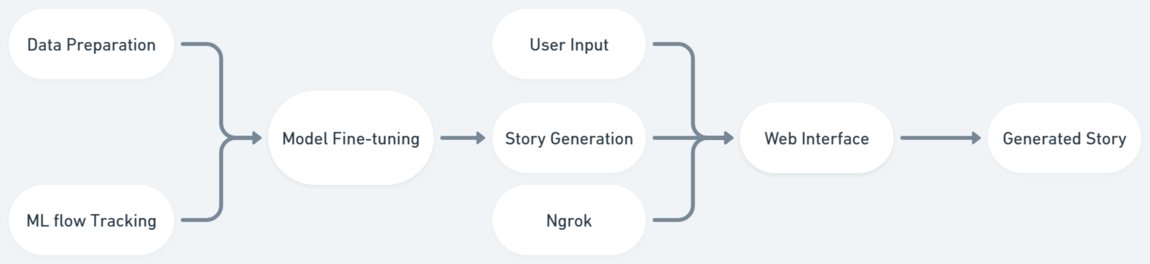
MODEL ARCHITECTURE

Slide 7
FINE-TUNING PROCESS
1
2
3
Loading
Pre-trained
model
Hyper-parameters
Tuning
Training
Method

Slide 8
FINE-TUNING PROCESS
1
Start with a pre-trained GPT-2 and further train it on the new dataset by adjusting layers to better understand the specific creative writing style.
Loading
Pre-trained
model

Slide 9
FINE-TUNING PROCESS
2
Adjust key parameters like learning rate, batch size, and epochs to control the training. For instance, larger batch sizes can help stabilize training, while more epochs might increase specialization.
Hyper-parameters
Tuning

Slide 10
FINE-TUNING PROCESS
3
The model is optimized using techniques like Adam optimizer and scheduled learning rates to gradually improve.
Training
Method

Slide 11


EVALUATION AND OUTPUT
EVALUATION METRICS
HUMAN
ASSESSMENT
Language models like GPT-2 are typically evaluated using metrics like perplexity, which measures how well the model predicts the next word.
For creative tasks, qualitative human evaluation is crucial (e.g., checking creativity, coherence, and originality of generated text).
CREATIVE
OUTPUT
Generate samples of creative content, such as poems, dialogues, or short stories. Highlight successful examples where the model produces engaging or imaginative content.

Slide 12


CONCLUSION
Practical Applications: Fine-tuned GPT-2 models can be used in content creation, scriptwriting, poetry generation, game narratives, and even in co-creative environments like writing assistants.

